Slide 1
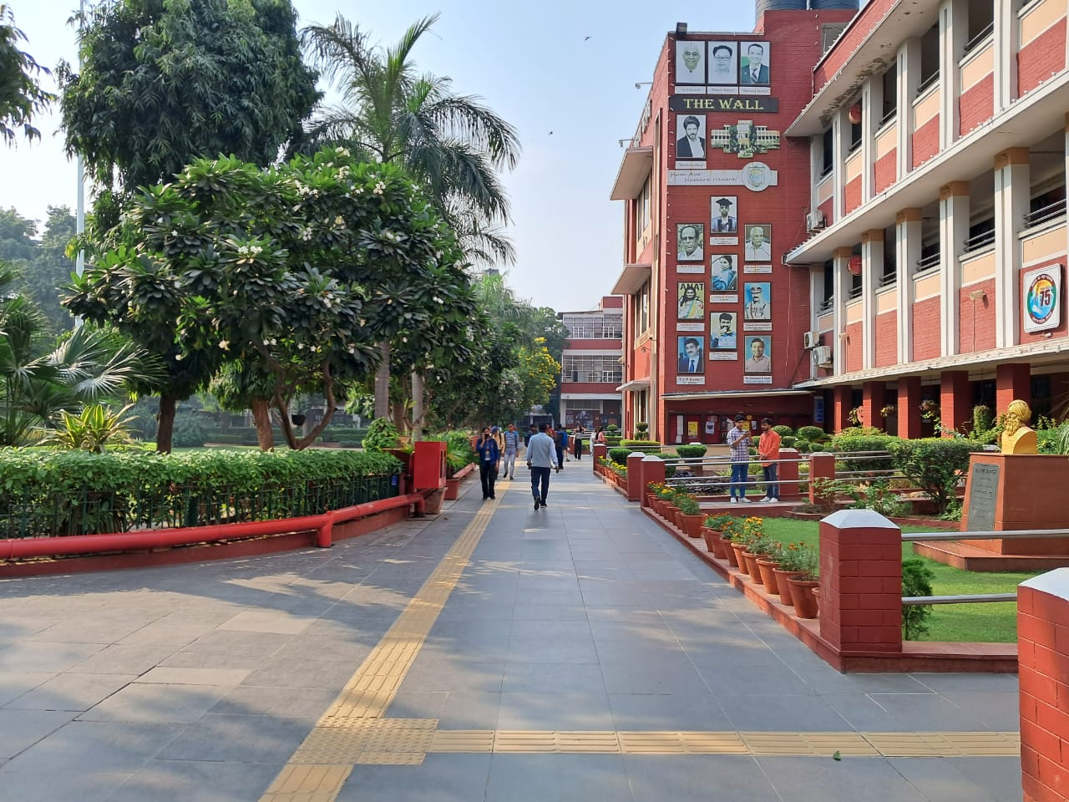
THE PLACEMENT CELL
HANSRAJ COLLEGE
PLACEMENT REPORT
SESSION 2022-23
www.placementhansraj.com
placementhansraj@hrc.du.ac.in

Slide 2
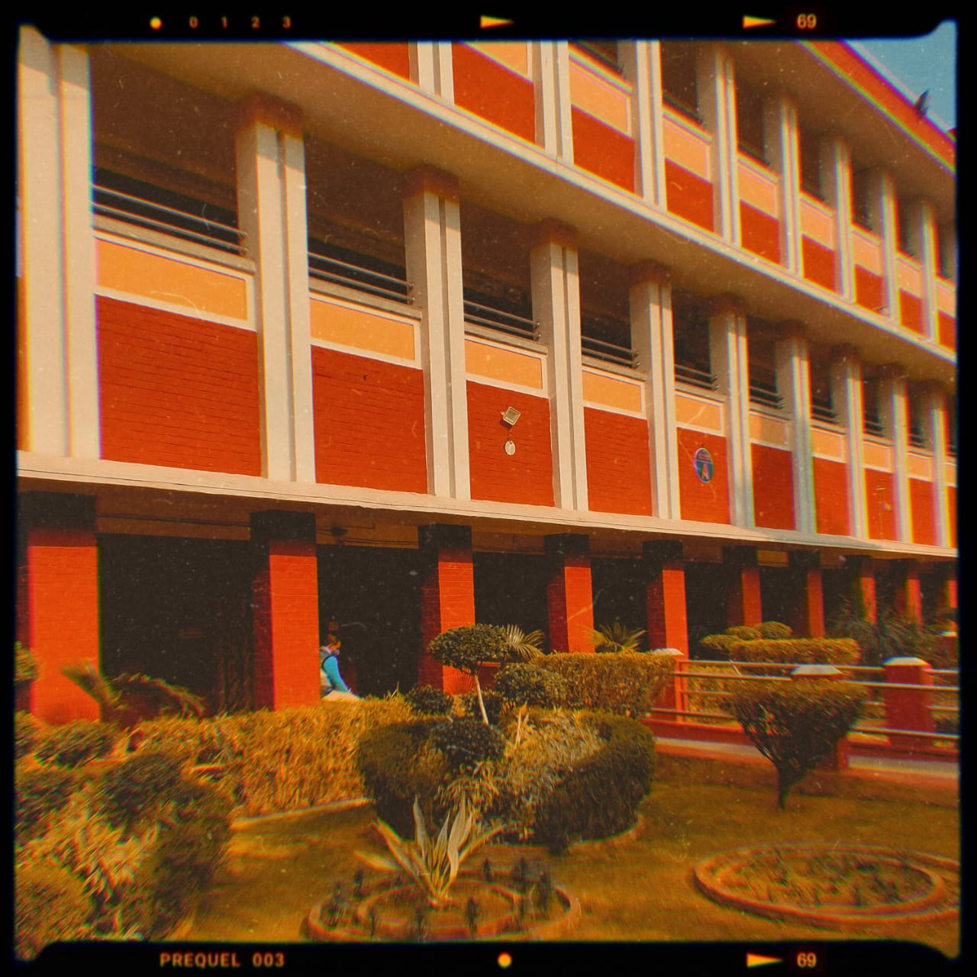
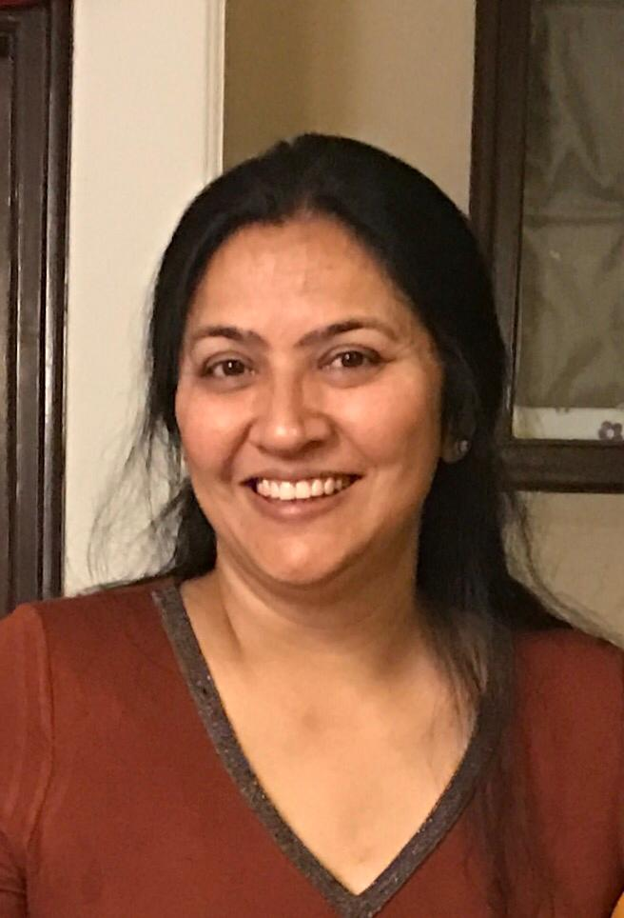
CONVENERS’ FOREWORD​
Dr. Alka Kakkar
Vice Principal
Dr. Shailu Singh
Convener
“
The Placement Cell plays a fundamental role in providing the right opportunities to the students as they embark upon their journey from college life to the corporate world. The finest academic talent pool of Hansraj has proved its capabilities over the years by becoming treasured assets of the organizations they have been a part of and how they have transformed themselves into astute and pragmatic leaders of the future.
The Cell has undertaken myriad initiatives to upskill the students and facilitate their holistic development so that they can make better-informed decisions and are better prepared for the dynamic and challenging placement processes besides fulfilling the gap to marry up the requirements of the companies with the right skill sets of the students.
The Placement Session 2022-23 witnessed 280+ firms from diverse sectors taking part in the placement drives and making 540+ offers to the students. It was a matter of pride to onboard a significant number of new and eminent organizations this year. This remarkable year-on-year surge in the number of new recruiters and the quality of the placement opportunities is a testimony to the utmost diligence and consistency of the Placement Team.
As we commence the next session, it gives us immense pleasure to extend a heartfelt welcome to our distinguished recruiters to take part in this journey towards excellence, and look forward to yet another record-breaking Placement Season!
”

Slide 3
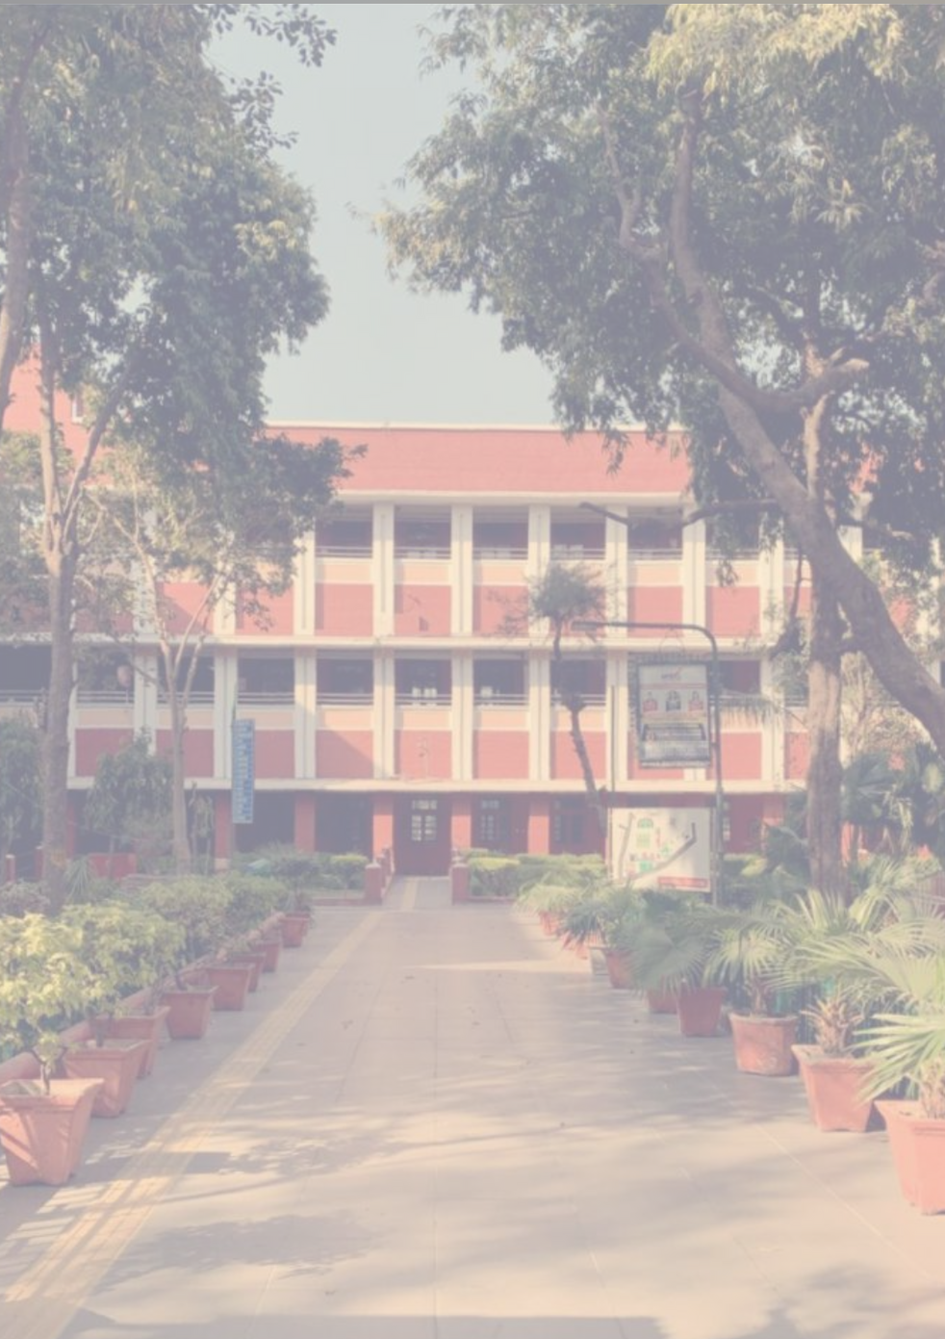
PLACEMENT STATISTICS 2022-23
36.5 LPA
Highest Package
7.9 LPA
Average Package
40+
Cr
Gross
Package Value
INDUSTRY-WISE BREAKUP
13.4 LPA
Top Quartile
Package
540+
Offers Rolled Out
Audit
Consulting
6.5
LPA
Median Package
Finance
Others
7.3 LPA
25 Cr+
340+
2022
2023
7.9 LPA
40
Cr+
540+
YEAR ON YEAR INCREASE
Average Package
Gross Package Value
Offers Rolled Out

Slide 4
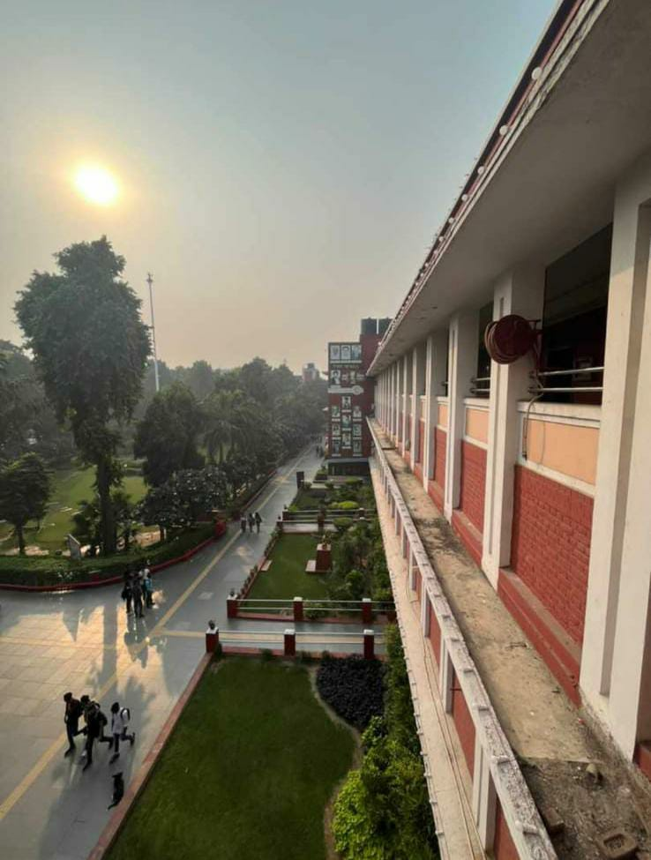
TRAINING AND WORKSHOP
Since the commencement of the Placement Season 2022-23, The Placement Cell, Hansraj College through its Training & Workshop department has strived to upskill the students and facilitate their holistic development by conducting numerous sessions covering diverse fields.
PREKSHA JAIN
NOV18
Preksha Jain, a Yale and Hansraj College graduate shared the learnings from her professional journey — from working at Bain & Co. to obtaining a Masters in Economics from Yale and then pursuing a career as a Consultant with the World Bank. She further provided insights into the application process for foreign universities. The interactive session witnessed participation from 200+ attendees who gained a unique perspective on careers in economics, consulting, and social impact.
JAN22
MENTOVERSE
A Consulting Masterclass was organized in collaboration with Mentoverse in January 2023. The masterclass was conducted by four Chartered Accountants who have work experience in major consulting firms including Bain & Co. and Boston Consulting Group. Attendees gained insights into the workings of various consulting firms and their recruitment processes. The speakers also shared strategies to excel in consulting interviews.
INSIDE IIM
MAR
12
In order to assist the students to form a better roadmap for their CAT preparation, a webinar was conducted with Sejal Sahni and Kritika Jalan as the speakers. Sejal is an IIM Ahmedabad graduate while Kritika is a graduate from XLRI Jamshedpur. The session witnessed 300+ registrations and students gained valuable insights regarding the preparation strategies to ace the CAT exam.
MAR25
FINANCE
A session was conducted to provide clarity to students who aspire to pursue a career in the Finance sector. This session was conducted with Mr. Jitendra Attra, who is the Chief Financial Officer at Zuno General Insurance. The speaker shared insights into the various opportunities available in the core Finance sector for undergraduate students and how one should prepare themselves to be a suitable fit.
WORKBOOK
MAY
06
The Placement Workbook is an initiative undertaken by The Placement Cell, Hansraj College with the aim to guide students in their placement preparation journey. The workbook contains detailed information on the placement process of 20 prominent companies recruiting from Hansraj, curated with reference to insights provided by the students successfully placed from the Batch of 2022-23 along with a repository of helpful resources to be studied.

Slide 5
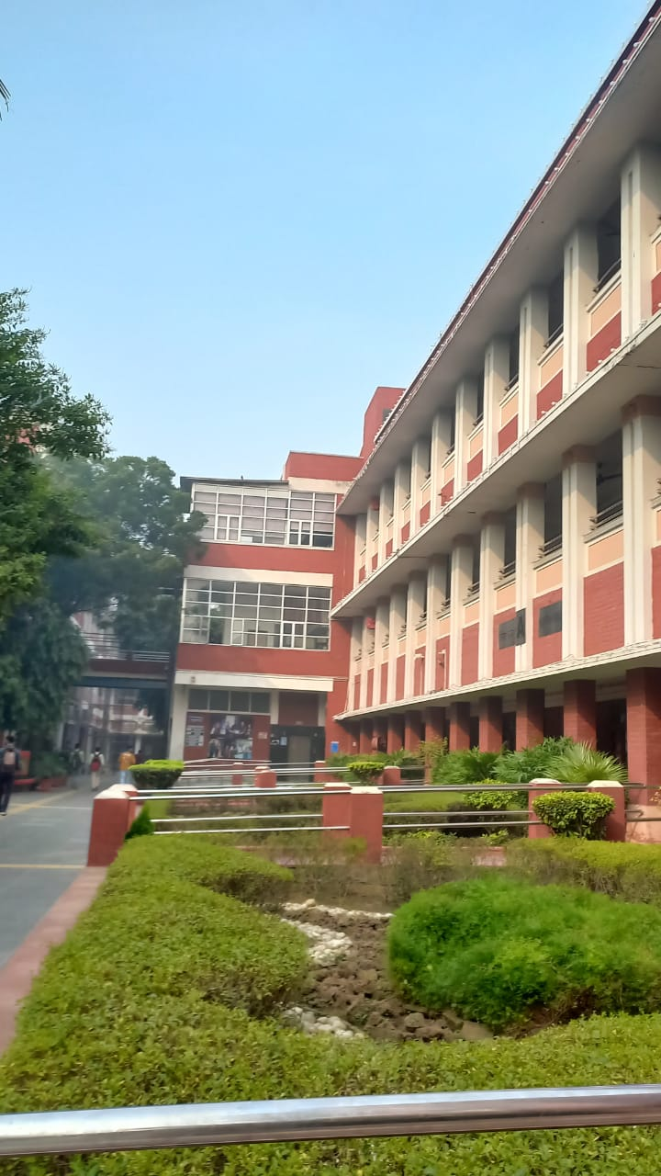
CORPORATE COMPETITIONS
Hansraj College has always strived to be a multidisciplinary institution. In its aim to foster an environment where creativity and hard work hold supreme importance, the college encourages its students to engage in ample challenging and exhilarating competitions that not only assist students to develop their abilities to tackle practical challenges but also demonstrate their talent and hone their technical competence, thereby enhancing their confidence that manifests itself in all aspects of their lives.
The Placement Cell's affiliation with some of the most prominent companies during the Placement Season of 2022–23 was marked by the passionate involvement of students in corporate competitions encompassing the following:
Accenture Next - Horizon Strategy Connect
Accenture Next - Horizon Strategy Connect is a 2-day skill-based workshop and training program designed to help undergraduate students explore the world of modern consulting. Anuj Mittal won the Accenture Next – Horizon Strategy Connect. Owing to his remarkable performance in the competition, he bagged a PPI opportunity with Accenture. Avni Jain (Winner: Simulation Round), Varish Grover (Runner up: Quiz Round) and Lakshay Saini (Runner up: Simulation Round) emerged as the campus winners in the competition.
BrAINWARS by Bain Capability Network
BrAINWARS is BCN’s case study competition designed for top undergraduate campuses where the participants get a chance to experience the real consulting environment by analyzing and solving live case study problems. Team ‘Consulting Contortionists’ - Rakshit Bhatt, Muskan Gupta, Ashma Bakshi and Revanshi Bhatia and ‘USP Consultants’ - Pragati Singh, Shaurya Singh, Shourya Sharma and Utkarsh Agrawal - from Hansraj College emerged among the Top 30 teams in BrAINWARS, BCN's three-stage case study competition, which included 300 teams from various campuses across the country.
Deloitte Graduate School Maverick
Graduate School Maverick (GSM) is a competition conducted by Deloitte which enables students to gain exposure to the professional world and learn from Deloitte’s leaders and professionals. Team ‘Dash Consultants’ with members Akarsh Gupta, Garima Gupta, Kshitij Jain and Satyam Agarwalla (B.Com (H), Batch of 2024) made it to the Top 5 of Deloitte Graduate School Maverick Season 7 amongst 3600+ participants from 50+ campuses PAN India. Team Sapient Mavericks’ with members Akshita Kothari, Rakshit Bhatt, Revanshi Bhatia and Sampoorna Gupta also made it to the Pre-Finals (Top 12).
HSBC India Business Case Program
The HSBC/HKU Asia Pacific Business Case Competition is the world's largest business case competition for undergraduate students, aiming to enhance the future skills of students by challenging them to come up with creative and feasible solutions to solve real-life business cases. Team ‘Unresolved Solvers’ – Dipen Kumar, Garima Gupta, Khushboo Sadhwani, and Sahil Sharma - emerged as the National Finalists of the prestigious competition out of 200+ teams nationwide after 5 rounds. One more team from Hansraj College made it to the semi-finals.

Slide 6
OUR RECRUITERS

